Slide 1
Vietnamese Mahayana Buddhism
By Grant Harvey

Slide 2

Research Focus
Quan Am Buddhist Temple
Mixed ages and Genders, Vietnamese community, modest clothing

Slide 3
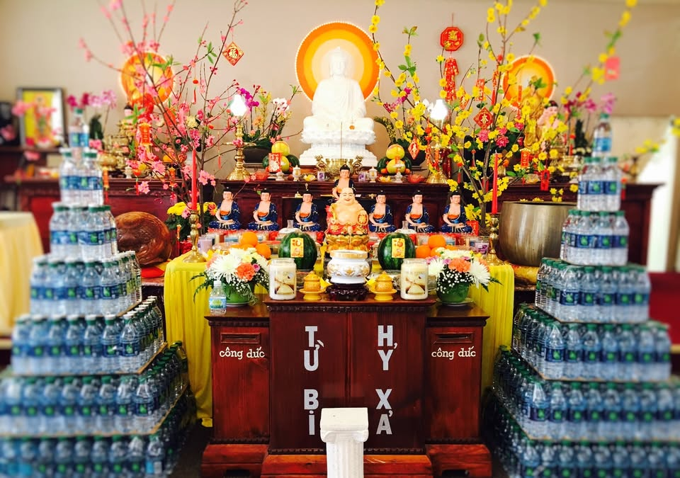

Music Observations
Feb 14 (8 AM), Feb 15 (11 AM)
Participants: Monks and congregation
  Faced Buddha statue
Sound: Chanting, bells, wooden percussion
Movements: Bowing, kneeling, synchronized chanting
Occurs during prayer and rituals

Slide 4
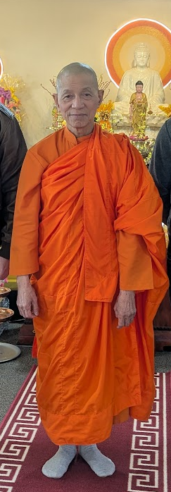
Venerable Thay Thich Phuoc Tri - Feb 14
“So I think music is more important for the ceremony and makes people like it, but the main practitioner in Buddhism is meditation, that is the most important thing.”
Meditation more central than music
Music helps engagement
Music is not for entertainment, but supports focus and spiritual practice

Slide 5

Tin & Francesca Nguyen - Feb 15
Attend mainly during holidays (New Years)
View temple as cultural and family gathering space
Doesn’t care for music service
Consumes music same way we would

Slide 6
Music and Movement in Vietnamese Buddhism
Vietnamese Buddhism includes chanting, ritual movement, and instruments
Music tied to rituals and events
Nguyen, Phong T. “Music and Movement in Vietnamese Buddhism.” The World of Music, vol. 44, no. 2, 2002, pp. 57–71. JSTOR, http://www.jstor.org/stable/41699426

Slide 7
Language, Orthodoxy, and Performances of Authority in Vietnamese Buddhism
Vietnamese Buddhism includes chanting, ritual movement, and instruments
Music tied to rituals and events
Music participants 80% - 90% women
Alexander Soucy, Language, Orthodoxy, and Performances of Authority in Vietnamese Buddhism, Journal of the American Academy of Religion, Volume 77, Issue 2, June 2009, Pages 348–371, https://doi.org/10.1093/jaarel/lfp017

Slide 8
Chapter 31 Contemporary Buddhist Chanting and Music
Vietnamese Buddhism includes chanting, ritual movement, and instruments
Music tied to rituals and events
Chanting often replaces “songs” in Buddhist traditions
Greene, Paul D., 'Contemporary Buddhist Chanting and Music', in Michael Jerryson (ed.), The Oxford Handbook of Contemporary Buddhism, Oxford Handbooks (2017; online edn, Oxford Academic, 5 Dec. 2016), https://doi.org/10.1093/oxfordhb/9780199362387.013.27

Slide 9
Research vs What I Saw
Findings align with literature
  Vietnamese Buddhism includes chanting, ritual movement, and instruments
  Music tied to rituals and events
  Music participants 80% - 90% women
  Chanting = Music

Slide 10
Christianity vs Buddhism
Similarity:
  Music used for worship
Difference:
  Christianity uses varied styles
  Buddhism focuses on repetitive chanting
  Christian music listened outside of church
  Buddhism music tied to events rather than daily practice

